Slide 1
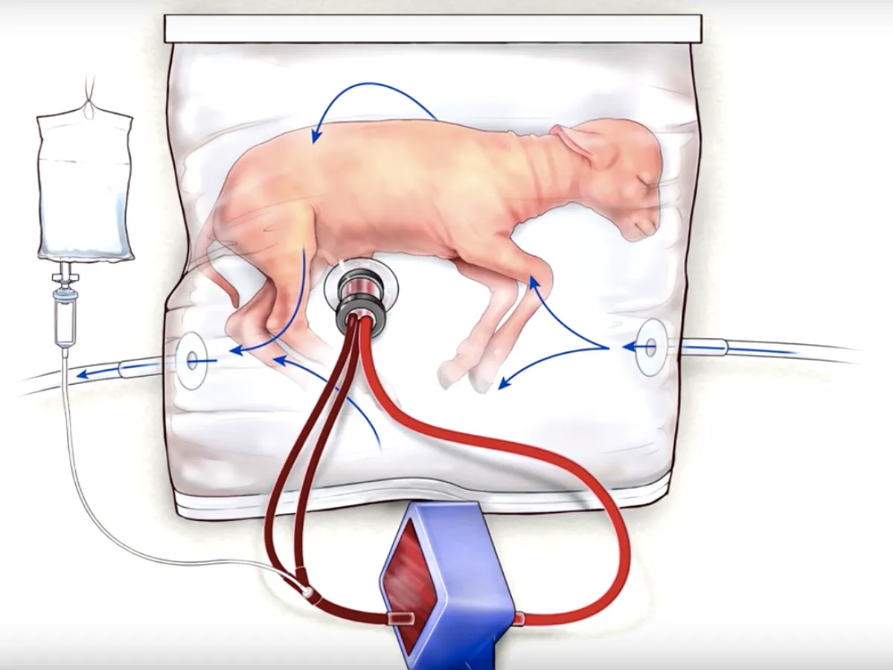
Artificial Uterus
Presentation by: Pan Martin

Slide 2
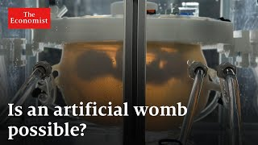
Overview
Slides 3-4: History
Slide 5: Plan
Slide 6: Implementation
Slide 7: Pros
Slide 8: Cons
Slide 9: Summary
Slide 10: References
What it is:

Slide 3
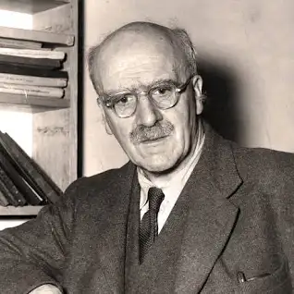
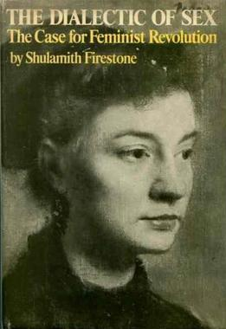
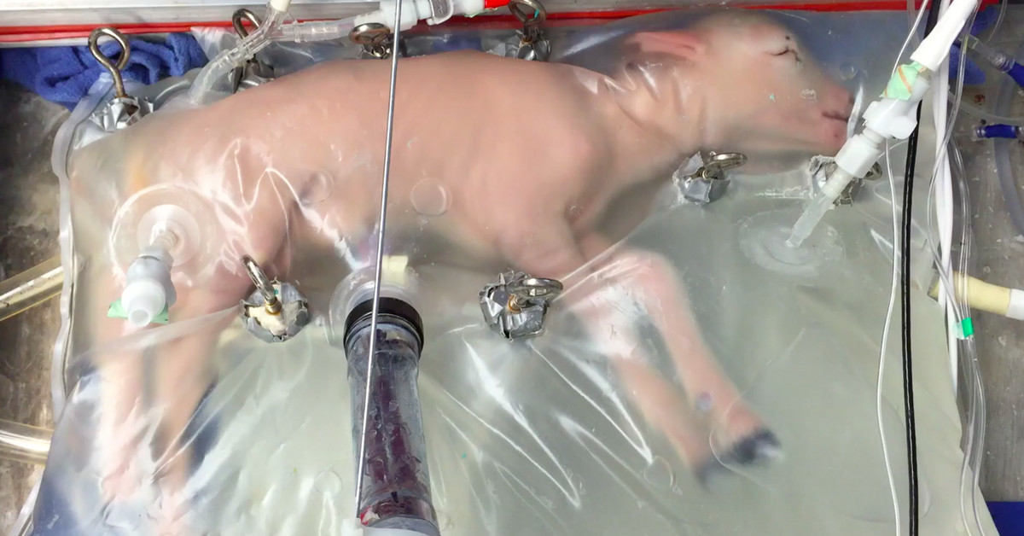
History
Brief Timeline:
1923- First extended discussion of artificial wombs (in lecture by J.B.S. Haldane)
1970- Shulamith Firestone takes up Haldane’s thesis in her book
2017- Researchers successfully sustain life within an artificial womb (using lamb fetuses)
J.B.S. Haldane, indian scientist
Shulamith Firestone’s book: The Dialectic of Sex
Baby sheep growing in artificial womb
Notes:
More information regarding the timeline:
J.B.S Haldane’s lecture in 1923 happened at the Heretics Society of the University of Cambridge. He imagined that by the 1960’s, all babies would be born from artificial wombs. This statement lead to many disagreements regarding the topic, mainly among well known feminists like Vera Brittain and Shulamith Firestone. “Firestone declared pregnancy to be barbaric, and that she argued ‘reproductive biology’ was a tyranny that produced fundamental gendered inequity. There could be a world, she imagined, in which some form of artificial gestation could communise reproductive labour, redistributing the burden of gestating to the whole of society. But Firestone cautioned that ‘in the hands of current scientists, few of whom are feminist or even female’, ectogenesis should only be viewed with suspicion.”(A history of gestation outside the body | Wellcome Collection). This excerpt is a good example of how some felt regarding Haldane’s proposition. Although Haldane's idea that all babies would be born from artificial wombs by the 1960’s did not happen, in 2017 a baby lamb was successfully sustained within an artificial womb. However, in the 1990’s an attempt to do this also took place, but unlike in 2017, it failed.

Slide 4
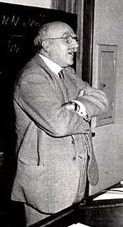
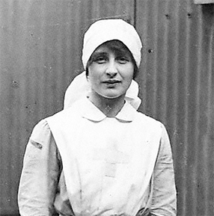
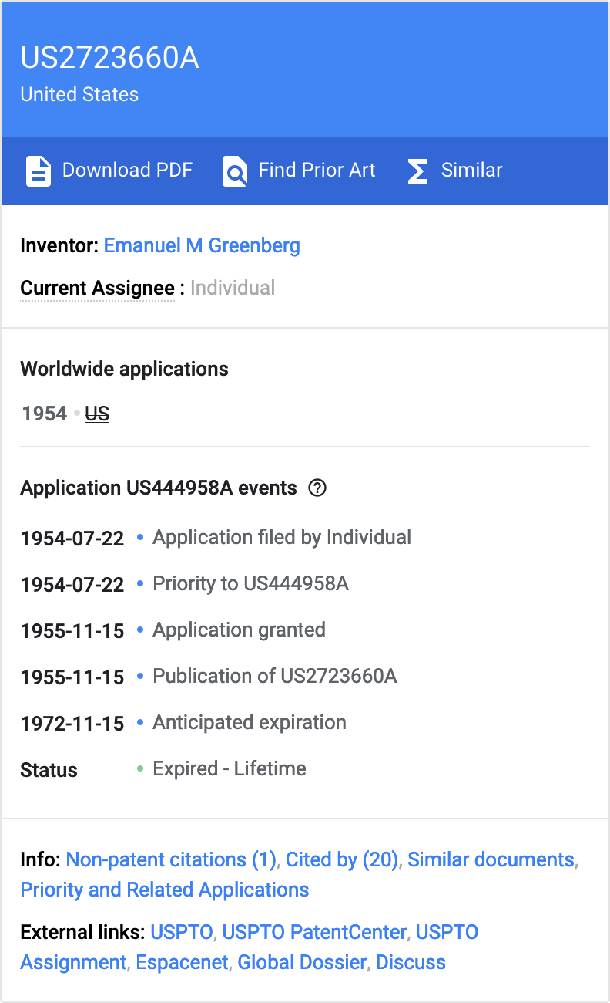
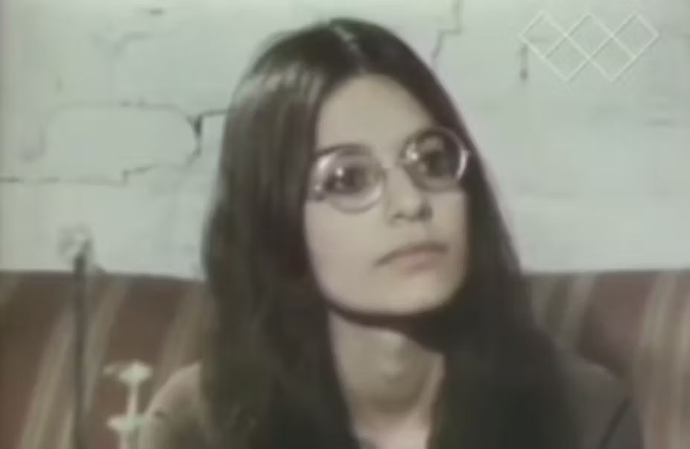
History
Important people:
J.B.S. Haldane
Emanuel M. Greenberg
Vera Brittain
Shulamith Firestone
J.B.S. Haldane: top left, Vera Brittain: top middle, Emanuel M. Greenberd’s patent: top right, Shulamith Firestone: bottom right
Notes:
More information regarding these people and who they were:
J.B.S. Haldane was the first to have a discussion regarding artificial wombs. He did so during a lecture at the University of Cambridge in 1923.
Although I could not find much regarding Emanuel M. Greenberg's contribution or study to the artificial womb, he was the first to patent it. He did so in 1954.
Vera Brittain was a feminist who spoke on how she felt in regards to the idea of artificial wombs. “In 1929, the English memoirist Vera Brittain wrote an essay suggesting that while ectogenesis might benefit some women, in the wrong hands, it could be misused.”(On the History of the Artificial Womb - JSTOR Daily)
Shulamith Firestone is described as a “radical feminist”, and her thoughts regarding the artificial womb were almost opposite of Brittain’s. Firestone believed that to achieve equality between men and women, pregnancy would have to be outsourced to primarily pregnancy machines like the artificial uterus. This is opposite of Brittain’s beliefs because while Brittain did acknowledge the usefulness that machines like these could provide, she was afraid of them being abused and used as an instrument to gain power. Meanwhile Firestone never expressed any concerns similar to this.

Slide 5
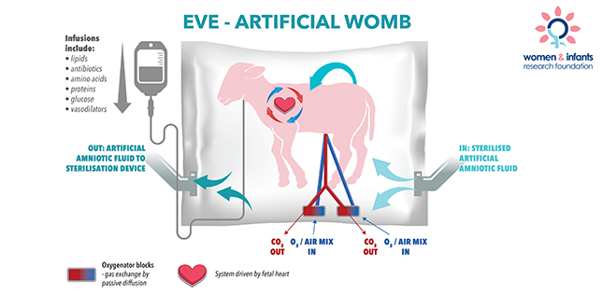
Plan
“An artificial womb is not designed to replace a pregnant person; it could not be used from conception until birth…”
(FDA advisers discuss future of ‘artificial womb’ for human infants (CNN)
By: Jen Christensen, CNN)
Notes:
Main source: FDA advisers discuss future of ‘artificial womb’ for human infants | CNN
More information on the plan for the artificial uterus:
As stated on the slide, the current artificial uteruses are NOT meant to replace a pregnant person. Instead they would most likely be used to help extremely premature babies (28 weeks or less). On average, only 1% of babies are born this early but that doesn’t necessarily imply a small number. An average of 140 million babies are born every year, 1% of that is still 1.4 million. premature birth is the leading cause of death and disability among infants, however by placing premature babies of 28 weeks old or less inside of an artificial uterus, that baby would live to term and not display any long term disabilities like most premature babies.

Slide 6
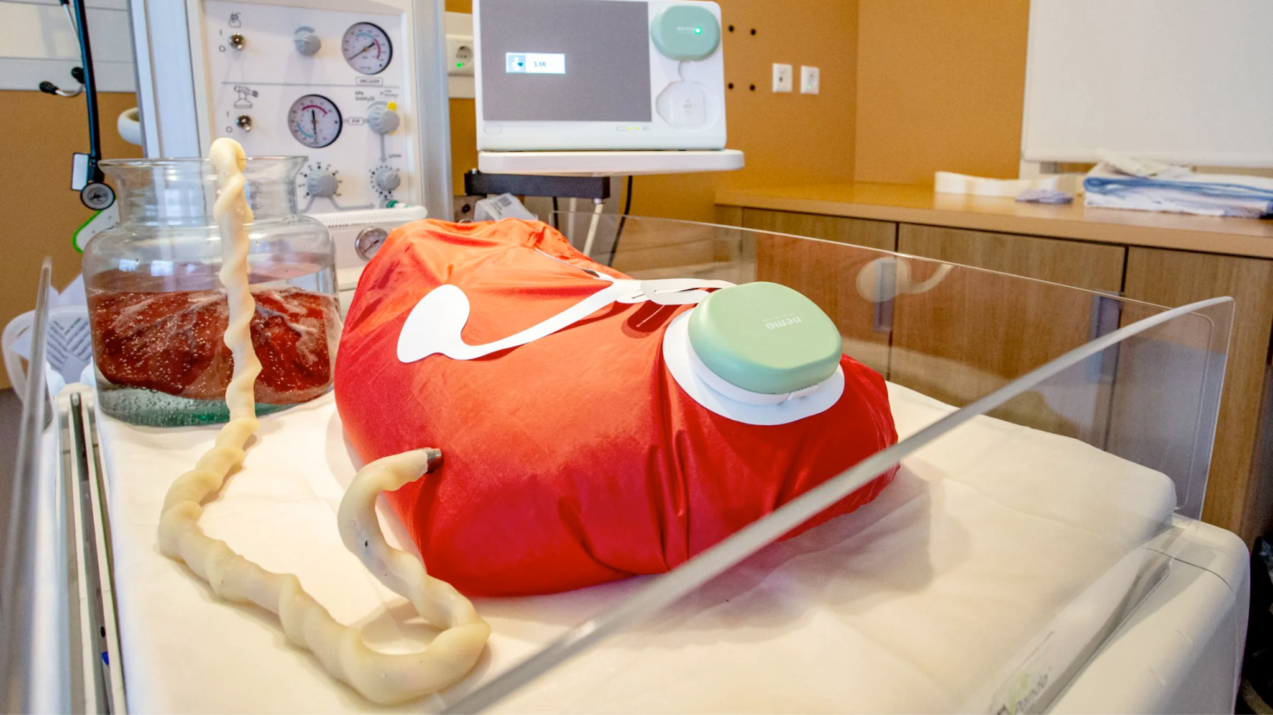
Implementation
“Selecting the right participants will be tricky. Some experts argue that gestational age shouldn’t be the only criteria. One complicating factor is that prognosis varies widely from center to center…”
(Everything you need to know about artificial wombs (MIT Technology review)
By: Cassandra Willyard)
Notes:
Main Source: https://www.technologyreview.com/2023/09/29/1080538/everything-you-need-to-know-about-artificial-wombs/
More information on how implementation of the artificial uterus is expected to go:
When implementation of artificial uteruses will begin is not certain and has not been confirmed, however we do know that the technology would first be used on infants born at 22 or 23 weeks because when they are this early there aren’t many other options. Choosing which babies to use may prove difficult though, this is because places like the University of Iowa Stead Family Children’s Hospital, have successfully kept some babies born at 21 weeks alive, without the use of an artificial uterus.

Slide 7
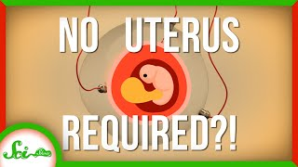
Pros
Pros of artificial uteruses:
may reduce the risks of morbidity and mortality
provide a clearer understanding of fetal physiology and development
This video also provides further insight into the benefits of artificial uteruses, as well as the science behind →
Notes:
More about the pros:
As mentioned on previous slides, a magor part of artificial uteruses is the fact that they will hopefully reduce the risks of disease and death in premature babies. Also, by being able to observe a baby in its last stages of development (when it is in teh artificial womb), biologists and doctors can gain further knowledge about fetal physiology and development.

Slide 8
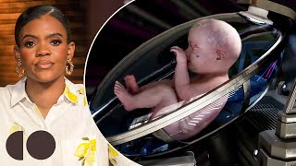
Cons
Cons of artificial uteruses:
the mother would have to undergo a C-section
devaluation of pregnancy and the associated risks of losing female empowerment
In this video some of the potential risks/cons of artificial uteruses are discussed →
Notes:
More about the cons:
Undergoing a c-section can be a very hard and traumatic experience for mothers, but it seems that it may be the only way to safely transfer a baby from the mother to a artificial womb. Also, there is the idea that this process could risk the loss of female empowerment, which was Vera Brittain's main concern regarding these machines.
An important thing to note about the video linked is that the woman in has a clear negative bias regarding artificial wombs. And that other topics like politics are discussed in the video that do not specifically relate to this slideshow or the cons of artificial wombs.

Slide 9
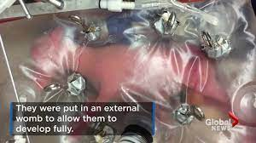
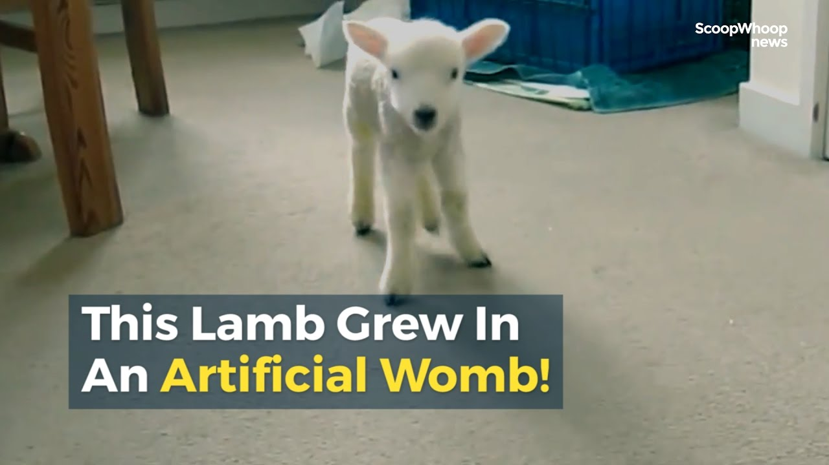
Summary
In conclusion, I am generally for this advancement in technology. I think that artificial wombs would prove to be very useful in the medical field and could potentially spare many parents from having to watch their babies die due to premature birth. As someone who is interested in the medical and biology fields, I look forward to hopefully seeing an artificial womb in action someday if/when they are implemented in hospitals and used on human babies and fetuses.

Slide 10
References
1.FDA advisers discuss future of ‘artificial womb’ for human infants | CNN
2.On the History of the Artificial Womb - JSTOR Daily
3.A history of gestation outside the body | Wellcome Collection
4.The Pros and Cons of Artificial Wombs
5.Artificial womb technology and clinical translation: Innovative treatment or medical research? - PMC
6.Scientists Create Artificial Womb That Could Help Prematurely Born Babies
7.Human trials of artificial wombs could start soon. Here’s what you need to know
8.Everything you need to know about artificial wombs | MIT Technology Review
9.Insanely Creepy Video Describes Invention of Artificial Womb
10.Big Breakthrough in Artificial Wombs | SciShow News
11.Are artificial wombs the future?

